Slide 1
SECURE DATA HIDING IN IMAGES USING STEGANOGRAPHY
CAPSTONE PROJECT
Presented By: Trishaa Kandhari
Student Name : Trishaa Kandhari
College Name & Department : VIT-AP University , B.Tech-CSE

Slide 2
OUTLINE
Problem Statement
Technology used
Wow factor
End users
Result
Conclusion
Git-hub Link
Future scope

Slide 3
Problem Statement
With the rapid digitalization of communication, ensuring data security and confidentiality has become a critical challenge. Traditional encryption methods are vulnerable to detection, making them a target for cyber threats. This project aims to develop a secure and imperceptible data-hiding mechanism using steganography to protect sensitive information within images, ensuring confidentiality, integrity, and undetectability from unauthorized access.

Slide 4
Technology used
Programming Language: Python
Libraries: OpenCV, NumPy, Pillow (PIL)
Steganographic Algorithm: Least Significant Bit (LSB) encoding, DCT-based steganography

Slide 5
Wow factors
Dual-layer security: Encryption and Steganography for enhanced security
AI-powered detection avoidance: Use of deep learning models to ensure hidden data remains undetectable
Multi-format support: Works with PNG, JPEG, and BMP without compromising image quality
End-to-end secure system: Can be integrated into a messaging app or secure file transfer system
Tamper Detection: An integrity verification system to check if data has been altered

Slide 6
End users
Government & Defense: Secure communication for intelligence agencies
Corporate Sector: Secure transmission of sensitive business documents
Journalists & Activists: Protect confidential sources and reports
Individuals: Personal data protection and secure file sharing
Medical Industry: Secure patient data transmission through medical images

Slide 7
Results
A fully functional steganography tool capable of embedding and extracting data from images without visible distortion.
The data remains undetectable by human eyes and most forensic analysis tools.Minimal file size alteration ensuring practical real-world usability.
AES Encryption : Added security by encrypting the data before embedding it into images.

Slide 8
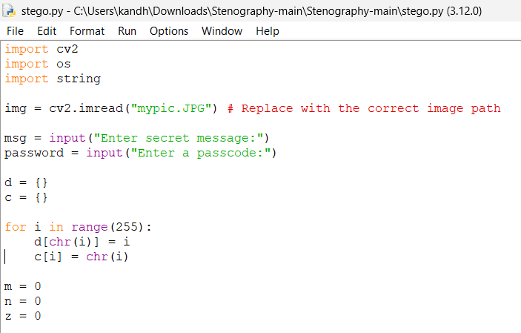
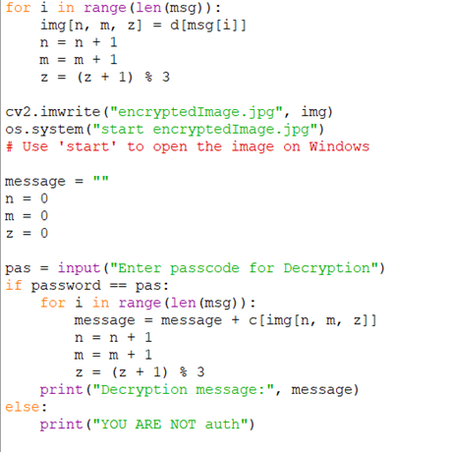
Results
INPUT CODE:

Slide 9
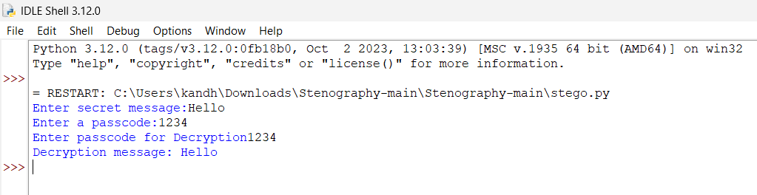
Results
SUCCESSFUL AUTHENTICATION CODE OUTPUT :
AUTHENTICATION ERROR OUTPUT :

Slide 10

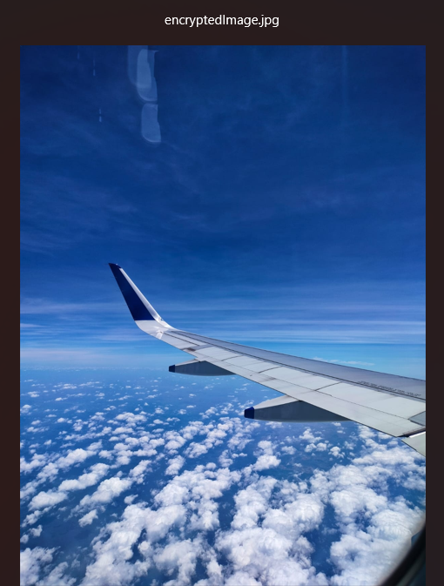
Results
INPUT IMAGE:
ENCRYPTED IMAGE(OUTPUT):

Slide 11
Conclusion
This project successfully implements secure data hiding using image steganography, offering a robust and untraceable way of transmitting sensitive information. It enhances privacy by making hidden data invisible to unauthorized parties, even under forensic scrutiny. By leveraging AI, encryption, and efficient image processing techniques, this project provides a next-generation security solution for confidential communication.

Slide 12
GitHub Link
https://github.com/TrishaaKandhari/Trishaa-Kandhari--AICTE-EDUNET-PROJECT.git

Slide 13
Future scope
AI-enhanced steganalysis resistance: Use of generative adversarial networks (GANs) to strengthen security.
Cross-platform Mobile App: Implement the system as a secure Android/iOS app.
Blockchain Integration: Use decentralized storage for tamper-proof data hiding.
Real-time Communication Integration: Implement steganography in video conferencing applications like Zoom or WhatsApp.
Steganography in 3D Models & GIFs: Expanding beyond images to 3D and animated media for more secure applications.

Slide 14
THANK YOU

